Slide 1
AI-Driven Alert Deduplication
and Incident Clustering
for SOC Efficiency
Pengfei Zhang
April 16, 2026
Notes:
Today I’ll present an AI-driven approach to reducing alert fatigue in Security Operations Centers by converting large volumes of alerts into structured, incident-level intelligence.

Slide 2
The Problem: Modern SOCs Are Drowning in Alerts
Alert Overload
Analyst Fatigue
Fragmented Triage
Suricata IDS generates hundreds of thousands of alerts per day; scans, brute-force, malware callbacks. Those alerts are largely duplicates of the same underlying attack.
Repetitive and high-volume alerts cause analysts to lose focus. Critical threats are missed and not because detection failed, but because triage could not keep up.
Static rule-based correlation splits related events across multiple tickets. This slows response time and have a higher change of causing investigations to miss the full attack chain.
Note: The goal is not more detection, rather it's converting detection into actionable intelligence.
Notes:
Modern SOCs are not limited by detection capability, but by the volume of alerts they must process. Systems like Suricata generate hundreds of thousands of alerts daily, many of which are duplicates of the same activity. This leads to analyst fatigue, slower response times, and missed threats. The core issue is not detecting activity but rather turning alerts into actionable intelligence.

Slide 3
The Approach
AI-Assisted Behavioral Clustering: No Custom Training
Replaces: Static rule-based correlation that splits or merges related events incorrectly
Uses: Pre-trained MiniLM-L6-v2 sentence transformer: no custom model training required
Groups: Alerts by semantic similarity: signature family, protocol, severity, and port context
Supports: DBSCAN, Hierarchical, and OPTICS clustering algorithms on AI-generated embeddings
Delivers: Analyst-ready incidents with timelines, summaries, infrastructure context, and visualizations
RULE-BASED vs AI CLUSTERING
Legacy Approach
AI Based
Static threshold rules
Semantic similarity
Manual signature updates
Zero model retraining
Fragmented alert tickets
Unified incident cases
Alert-level view
Attack-chain narrative
High noise ratio
Noise auto-isolated
Notes:
This project replaces static rule-based correlation with AI-driven behavioral clustering. Using a pre-trained model, alerts are grouped by semantic similarity rather than exact matches. This allows the system to unify related activity into single incidents without requiring any custom model training, producing structured, analyst-ready outputs

Slide 4
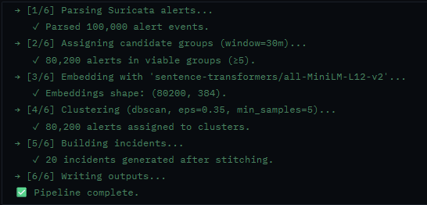
METHODOLOGY
Five-Stage Pipeline
1
2
3
4
5
Parse &
Normalize
AI Semantic
Embedding
Candidate
Grouping
Similarity
Clustering
Incident
Stitching
eve.json → structured records
(timestamp, IPs, ports, signature, severity)
MiniLM-L6-v2 → 384-dimentional vectors,
captures behavioral similarity
src_ip + 30-min default time window
Reduces computational complexity
DBSCAN/Hierarchical/OPTICS
on cosine-distance embeddings
Alert groups → analyst incidents
With IDs, summaries & timelines
Notes:
The system follows a five-stage pipeline. Alerts are parsed and normalized, then converted into semantic embeddings. They are grouped by time and source context, clustered using density-based algorithms, and finally stitched into incidents. The output includes timelines, summaries, and key infrastructure details

Slide 5
TECHNOLOGY USED
Technology Components
AI / Embedding
Clustering
Sentence-transformers/all-MiniLM-L6-v2
384-dimensional semantic vectors
Local hf_cache for repeatability
Hugging Face model registry
DBSCAN (density-based)
Hierarchical / Agglomerative
OPTICS (variable density)
Scikit-learn cosine distance
Visualization
Infrastructure
UMAP / PCA / t-SNE projection
Interactive Plotly Scatter Plot
Incident cards with full drill-down
Severity & signature distributions
Suricata EVE JSON ingestion
Streamlit web dashboard
Parquet + JSON output
Python modular pipeline
Notes:
The system uses a lightweight and practical stack. It relies on a pre-trained embedding model, standard clustering algorithms, and a Streamlit dashboard for visualization. A local embedding cache improves performance and ensures consistent, repeatable results

Slide 6
SYNTHETIC TEST DATASET
100,000 Alerts · 20 Known Campaigns · 21,050 Noise Alerts
Campaign | src_ip | Alerts | Sev
SSH brute-force | 192.168.10.5 | 6,000 | 2
RDP brute-force | 192.168.10.6 | 5,000 | 2
FTP brute-force | 192.168.10.7 | 2,500 | 2
Telnet brute-force | 192.168.10.8 | 2,000 | 2
Nmap TCP port scan | 192.168.20.1 | 10,000 | 2
ICMP ping sweep | 192.168.20.2 | 1,500 | 3
UDP service discovery | 192.168.20.3 | 1,200 | 3
Log4Shell exploit | 185.220.101.1 | 4,000 | 1
SQL injection | 185.220.101.5 | 6,000 | 1
XSS / web app attack | 185.220.101.6 | 3,000 | 2
Campaign | src_ip | Alerts | Sev
Cobalt Strike C2 | 10.0.0.77 | 8,000 | 1
Emotet C2 callbacks | 10.0.0.78 | 5,000 | 1
SMB / EternalBlue | 10.0.0.20 | 6,000 | 1
WMI/DCOM lateral | 10.0.0.21 | 2,500 | 1
DNS tunnelling / DGA | 192.168.30.1 | 4,000 | 2
Data exfiltration | 10.0.0.88 | 3,000 | 2
Tor anonymisation | 10.0.0.99 | 2,000 | 2
Cryptomining | 10.0.0.111 | 2,500 | 2
Shellshock RCE | 45.33.32.156 | 3,000 | 1
PrintNightmare | 10.0.0.22 | 3,000 | 1
Notes:
To validate the system, I used a synthetic dataset with 100,000 alerts across 20 known attack campaigns. These include brute-force attacks, malware command-and-control, scanning activity, and exploitation attempts, providing a realistic test of SOC conditions

Slide 7
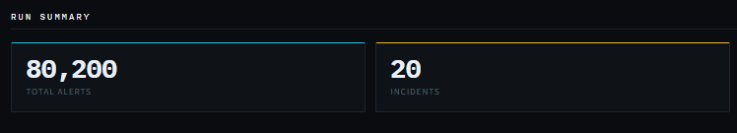
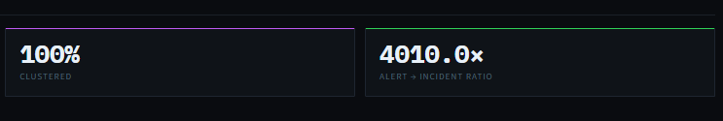
Benchmark Results
20 / 20
80,200
100%
4,010:1
Campaigns
Recovered
Alerts
Clustered
Clustering
Coverage
Alert / Incident
Compression
✓
Every campaign returned exactly 1 incident. No splits and no merges
✓
0 noise alerts left un-clustered, 100% coverage
✓
Reproducible: same output on repeated runs from embedding cache
✓
Confirmed across small (965 alerts) and large (100k) synthetic datasets
Notes:
The results are the key takeaway. The system reduced 100,000 alerts into exactly 20 incidents, achieving a 4,010-to-1 reduction ratio. All campaigns were recovered with no splitting or merging errors, and clustering coverage reached 100 percent. This confirms the system’s accuracy and scalability

Slide 8
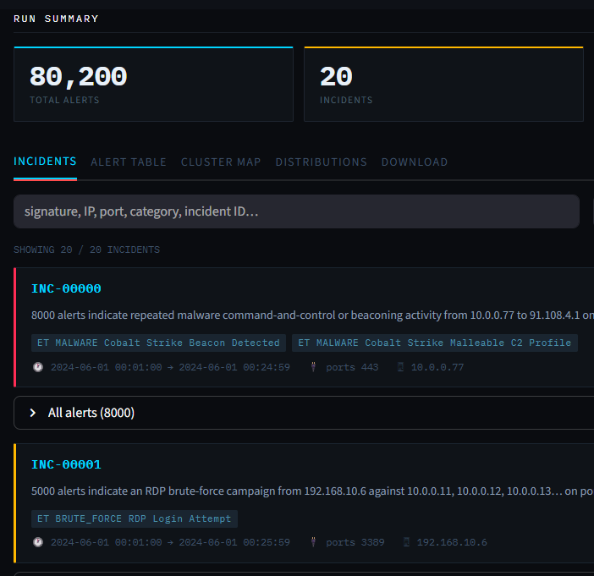
STREAMLIT DASHBOARD
Executive-Ready Interface
Run Summary
Alert count, incident count, noise ratio, compression ratio
Incident Cards
Expandable cards with all alerts, signatures, timelines, source/destination IPs, and ports
Cluster Map
UMAP / PCA / t-SNE projection with per-incident colouring and hover drill-down
Distributions
Alerts per cluster, top signatures, severity breakdown, source IP analytics
Notes:
The system outputs results through an interactive dashboard. It provides run summaries, incident views, clustering visualizations, and distribution analytics. This allows analysts to move from raw alerts to structured investigations in a single interface

Slide 9
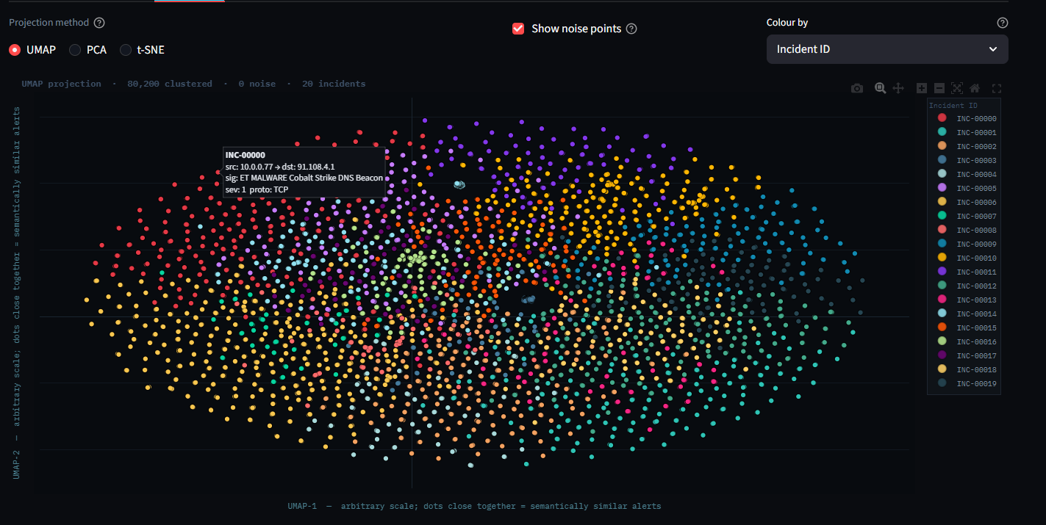
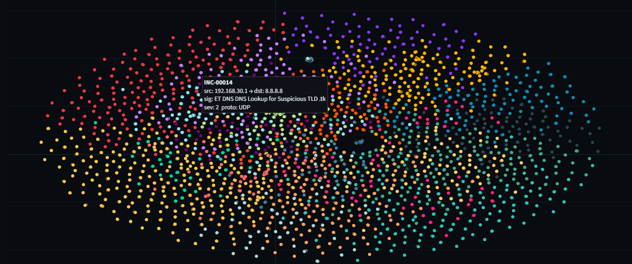
CLUSTER VISUALIZATION
UMAP Projection — 80,200 Alerts, 20 Semantically Separated Incidents
Each dot:
= one alert, coloured by incident ID
Proximity:
= semantic similarity — alerts that behave alike cluster visually
Oval shape:
= UMAP projection artifact, not a clustering defect
Real signal:
= exact campaign recovery, not 2D geometry
Pengfei Zhang · IST 584 · April 2026 | Cluster Visualization
Notes:
This visualization shows over 80,000 alerts grouped into 20 incidents. Each point is an alert. The circular layout is a projection artifact from UMAP and does not indicate clustering issues. The important point is that alerts are grouped correctly by incident

Slide 10
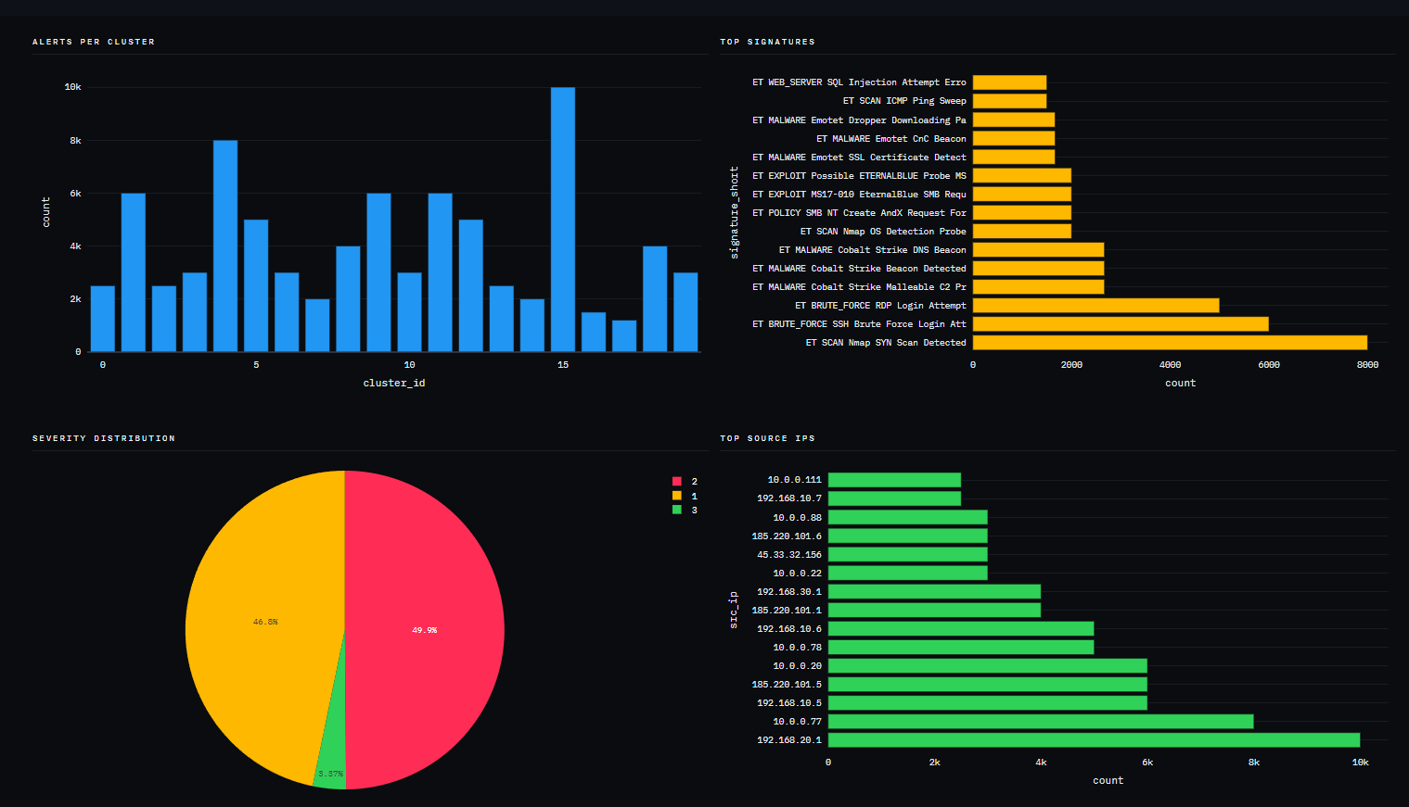
ANALYTICS DASHBOARD
Distributions Tab: Adversary Infrastructure at a Glance
Notes:
This view highlights key distributions, including signatures, severity levels, and source IPs. It provides immediate visibility into attack patterns and adversary infrastructure, supporting faster investigation and prioritization.

Slide 11
KEY INSIGHTS
What I Learned Building This System
01
AI + Security Integration Works at Scale
04
Explainability Builds Analyst Trust
Semantic clustering with incident stitching reduced 100,000 alerts to exactly 20 incidents. The AI layer directly improves SOC triage.
Matching the cluster map with incident IDs, adding severity views, source-IP analytics, and incident cards made the dashboard easier to understand and more like a real SOC workflow.
02
UMAP Visuals ≠ Clustering Truth
05
Next Step: Enterprise Validation
Circular UMAP layouts are normal on balanced datasets. It is a projection artifact. The validation signal is exact incident recovery and not 2D geometry.
The prototype gave strong results on synthetic data. Next, will be to test with benign and malicious enterprise telemetry to measure false positives, false merges, and long-duration campaign stitching to ensure it is enterprise ready
03
Local Cache Design Matters
Keeping HuggingFace models and embeddings in a local hf_cache/ directory reduced embedding time, improved stability, and prevented large files from polluting the GitHub repository.
Notes:
There are four key insights. First, AI and security logic integrate effectively at scale. Second, visual layouts like UMAP must be interpreted carefully. Third, local caching significantly improves performance and stability. And fourth, explainability features are critical for analyst trust. The next step is validating the system with real enterprise data

Slide 12
OPERATIONAL IMPACT
Faster Triage + No Extra Headcount + No Infrastructure Overhaul
Before This System
With This System
Analysts would manually review thousands of repetitive alerts per shift
Related attack events split across unconnected tickets
Critical threats buried in alert noise
High burnout rate leads to missed detections
Prototype tested 100,000 alerts compressed to 20 prioritized incident cases
Full attack chain preserved: brute-force → lateral move → C2
Analysts focus on investigating incidents rather than sorting alerts
Faster response, better prioritization, and same team size
Notes:
The operational impact is clear. Instead of reviewing thousands of alerts, analysts receive a small set of structured incidents. This enables faster triage, better prioritization, and improved efficiency without increasing headcount or changing infrastructure

Slide 13
CONCLUSION
Proof-of-Concept to
Decision-Support Prototype
20/20
Campaigns
Recovered
100,000 alerts → 20 incidents → 4,010:1 compression. Every campaign recovered. No custom training. The engine has moved from experiment into a stable prototype that demonstrates reduces analyst fatigue while preserving the full attack narrative.
4,010×
Alert
Compression
0
Training
Required
Notes:
In summary, this system demonstrates that AI-driven clustering can reduce alert fatigue while preserving full attack context. It moves SOC workflows from alert sorting to incident analysis and represents a practical step toward scalable, AI-assisted security operations.
This project matters because it addresses a core risk in cybersecurity operations: missed threats due to alert overload. It reduces analyst workload while preserving full attack context, improving both speed and accuracy of response. It also creates an opportunity to integrate AI into existing SOC workflows without the cost and complexity of building new systems. The result is a more scalable, efficient, and resilient security operation

